Slide 1
Fresno K-16 Collaborative Executive Steering Committee
June 4, 2021
3:00 – 4:30 pm
Link to Meeting Materials https://tinyurl.com/yd4dk4mz
Chair, Dr. Carole Goldsmith
Co-Chair, Dr. Saul Jimenez-Sandoval

Slide 2
Approval of June 4, 2021 meeting minutes

Slide 3
Contractual Key Dates
Budget FY Rollover Forms Due July 25, 2021 September 3, 2021: Progress Report 2 summarizing student outcomes to date (Spring 2021, Summer 2021, Fall 2021 cohort enrollments). March 31, 2022 December 31, 2021: Period of performance for each grant award concludes. April 15, 2022 January 28, 2022: Final invoicing for expenditure through March 31, 2022 due. April 15, 2022 January 28, 2022: Final Report 3 summarizing student outcomes through the end of the performance period and projected to the end of the Academic Year 2021-22

Slide 4
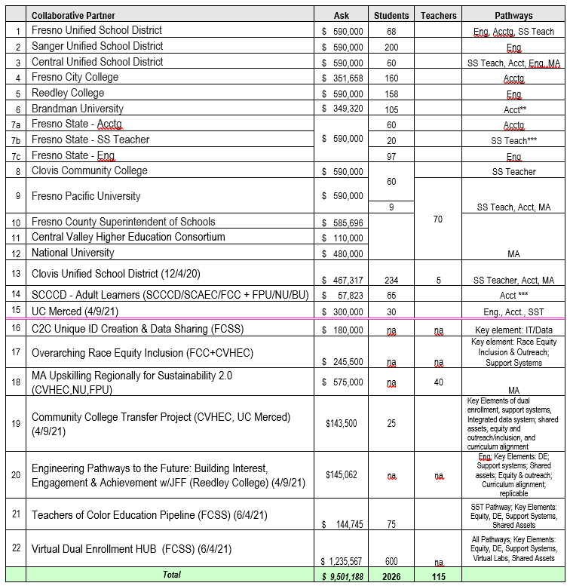
22 Projects by the Number
Total Ask to Date:
$9,501,188
Remaining Availability:
$0
100% of the funds have been awarded to projects
Notes:
$ 9,501,188
K-12 46%
postsecondary 54%
K-12 HS $ 4,383,325 46%
comm coll $ 1,875,043 20%
4 yr public $ 890,000 9%
4yr private $ 1,919,320 20%
other $ 433,500 5%

Slide 5
Collaborative Partner 2yr Pilot Pathway Projects
Accounting & Financial Mgt.
Engineering
Single Subject Teachers
Education – Dual Enrollment Teachers (Upskilling - Master’s degrees for high school teachers to teach dual enrollment)
115 Teachers 5.4%
Investment YTD | Students | Teachers
$ 9,501,188 | 2026 | 115
Total human touchpoints | 2141 | student/ teachers
 | $4,437.73 | investment per student/ teachers
1136 Students- High School & Transfers
90.6%
Notes:
Total 2141
5.4% teachers (#115)
94.6% student (#2026)
(90.6% hs#1836; 9.4% adult learners #190)
100% student investment
Investment Students-2026
HS & Transfer 1836
Masters' Candidates 115
Adult Learners 190
NOTE: Great news! These proposal commitments are not inclusive of teachers, faculty, staff participating in trainings/PD and REI PD to faculty, staff, teachers, admin, community - est. >1000;
Round 2 proposals under development including the virtual DE Hub; and Bridge-Type Programs, collectively >1000

Slide 6
Virtual Dual Enrollment
HUB
Equitable and Multiple Dual Enrollment Opportunities Help Close the Equity Gap and Bring Hope to Students to See Themselves as College Students
Upward Mobility
Equity
Prosperity

Slide 7
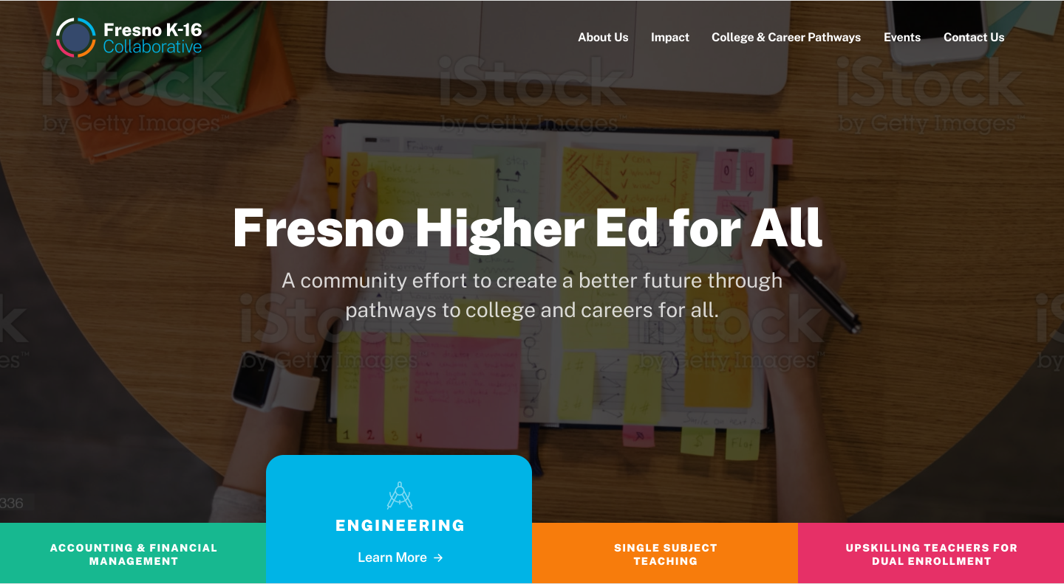
Website Demo

Slide 8
Next Steps and Possibilities

Slide 9
Next Fresno K-16 Collaborative Executive Steering Committee Meetings:
Friday, October 8, 2021, 3:00-4:30 (ZOOM)
Collaborative Partners
Stakeholder Partners (partial list)

