Slide 1
Unique ID Project
October 8, 2021

Slide 2
Operationalizing Unique ID to Track Dual Enrollment Progress
System to obtain and use unique ID across K-12 and higher education
Vendor to build a place to upload data and receive back Unique ID
Partners operationalize by inserting into their own database to facilitate matching for data projects
Leverage and build off existing Dual Enrollment Dashboard
Track progressions of students in Dual Enrollment programs
Do students continue in Dual Enrollment focus area?
Are there barriers to success?
What are the outcomes of Dual Enrollment Students vs not?
What Dual Enrollment programs are offered at which schools across the County and how does that relate to job openings?
Notes:
David

Slide 3
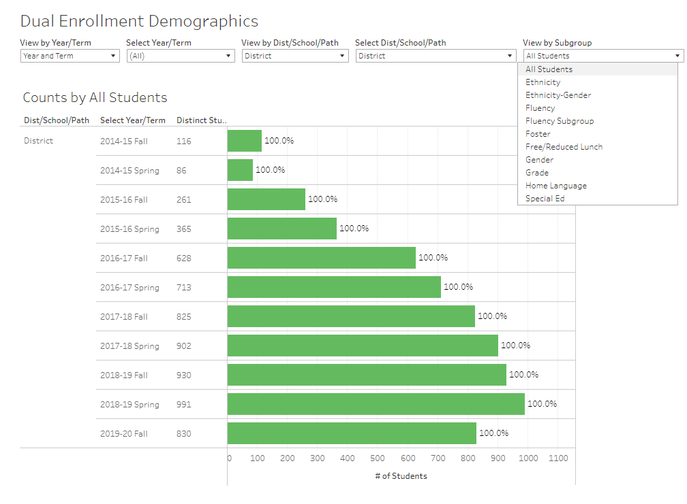
Dashboard #1: Fresno County Dual Enrollment Participation
Sample from Oakland
Collecting de-identified data (ie no names) from districts
So far have 11/19 districts’ data
Goal is to complete by December

Slide 4
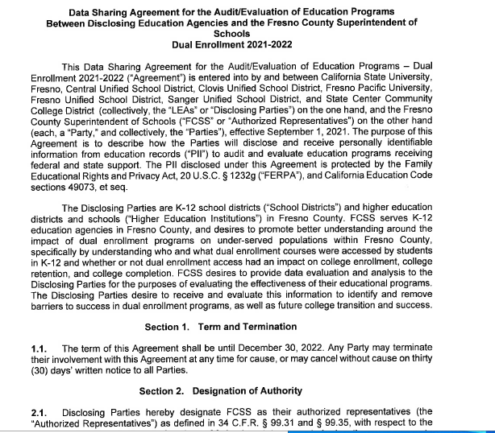
Dashboard #2 – Data Sharing Agreement
Signed by 8 Partners:
FCSS
Central Unified
Clovis Unified
Fresno Unified
Sanger Unified
Fresno Pacific
Fresno State
State Center

Slide 5
Indicators/data to be shared

Slide 6
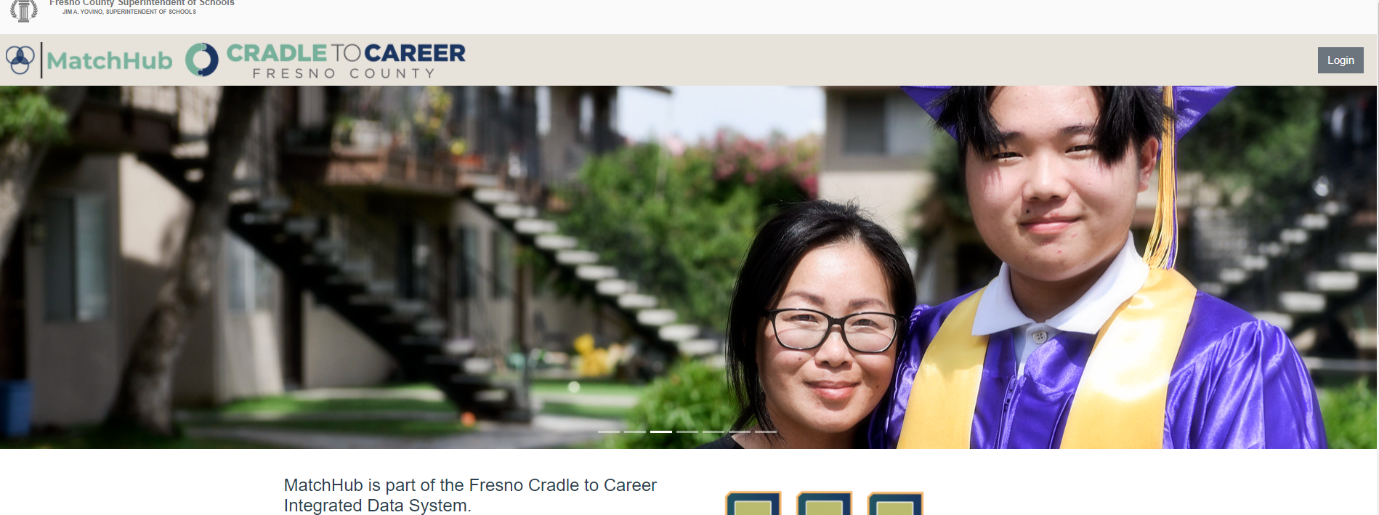
Infrastructure to Support: MatchHub
Matching at the person level across systems is the greatest technical challenge
MatchHub operationalizes a Unique ID for this purpose

Slide 7
1. Organization uploads data (First Name, Middle Name, Last Name, DOB, Gender, Agency ID)

Slide 8
2. MatchHub runs matching algorithm and identifies “matches”, “partials” and “no match”

Slide 9
3. Organization gets back their file which now includes a newly generated Unique ID to be leveraged for data sharing projects

Slide 10
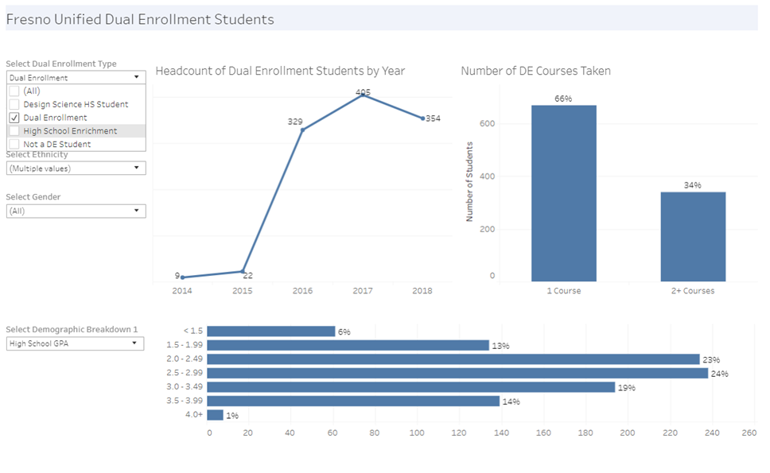
#1 – How many students are taking dual enrollment courses?

Slide 12
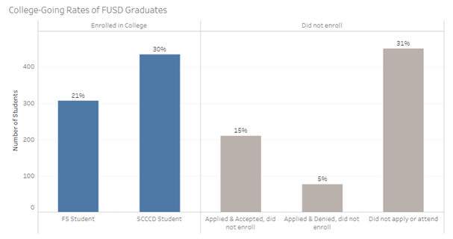
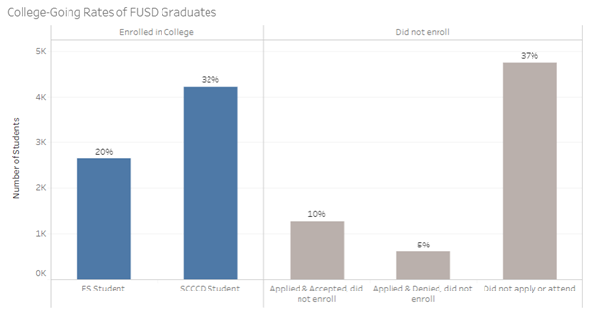

Slide 13
Questions?
Amber Jacobo-Roush, EdD
Director of Integrated Data Systems
Fresno Cradle to Career, FCSS
ajacobo@fcoe.org

