Slide 1

Fresno K-16 Collaborative Executive Steering Committee
February 5, 2021
3:00 – 4:30 pm
Link to Meeting Materials https://tinyurl.com/FK16C-SCFeb421
Chair, Dr. Carole Goldsmith
Co-Chair, Dr. Saul Jimenez-Sandoval

Slide 2
AGENDA https://tinyurl.com/FK16C-SCFeb421
Next Fresno K-16 Collaborative Executive Steering Committee Meetings:
Friday, April 9. 5, 2021
3:00-4:30pm
Friday, June 4, 2021
3:00-4:30pm
Welcome and Introductions – Chair President Carole Goldsmith
Approval of December 4, 2020 meeting minutes
Executive Director Updates (5 min) – Karri Hammerstrom
  Gov Newsom's Council for Postsecondary Education website http://capostsecondaryforall.org is LIVE & shares their work, including initiatives: The Recovery With Equity Taskforce & The Fresno K-16 Collaborative
    RFP/Scope of Work for coordinating Collab outward facing website
  Upcoming report to the Gov’s Council, Feb 11th
  Virtual Dual Enrollment HUB meeting, Wed., Feb. 24, 2021, 11am
  DRIVE-Sankofa Race Equity review – March
  In the news – CVHEC Newsletter, CCC Chancellor’s Office Vision in Action, Jan 28, 2021
Program Proposal Updates (20 min) – Hammerstrom
  Investment Breakdown Update
  Additional Round 2 project proposals being requested for consideration for FY 20-21
    Virtual Dual Enrollment HUB investment (HS guidance counselor professional development; HS Canvas subscriptions; website landing page and IT upgrades; DE specialists, outreach and marketing)
    Available funding
  Program Progress & Successes
  Programmatic contracting & funding
Progress Report 1 Due March 19, 2021 (deadline extended from Feb 5th) & Key Dates (3 min) – Hammerstrom
  March 19, 2021: Progress Report 1 summarizing plan implementation to date, activities and student cohort data to date.
  September 3, 2021: Progress Report 2 summarizing student outcomes to date (Spring 2021, Summer 2021, Fall 2021 cohort enrollments).
  December 31, 2021: Period of performance for each grant award concludes.
  January 28, 2022: Final invoicing for expenditure through December 31, 2021 due.
  January 28, 2022: Final Report summarizing student outcomes through the end of the performance period and projected to the end of the Academic Year 2021-22
6. Roundtable - Pilot Pathway Working Groups/Communities of Practice Updates (10 min) – PATHWAY CO-LEADS
  Spring 2021 Objectives and Outcomes
    Accounting and Fiscal Management/ Dual Enrollment (Goldsmith/Jiménez-Sandoval)
    Engineering/ Dual Enrollment (Buckley/Jiménez-Sandoval)
7. Partner Program Updates and Announcements / Other (15 min) – Collaborative Partners
  Brandman University Announcement and Name Change
  Obstacles & Opportunities
8. What’s Next & Adjournment (5 min) – Goldsmith / Hammerstrom
  Pilot Working Group/Communities of Practice meetings ongoing
  Virtual Dual Enrollment HUB meeting, Wed., Feb. 24, 2021, 11am
  Upcoming Next K-16 Collaborative Steering Committee Meetings:
    Friday, April 9, 2021, 3:00-4:30pm
    Friday, June 4 ,2021, 3:00-4:30pm

Slide 3

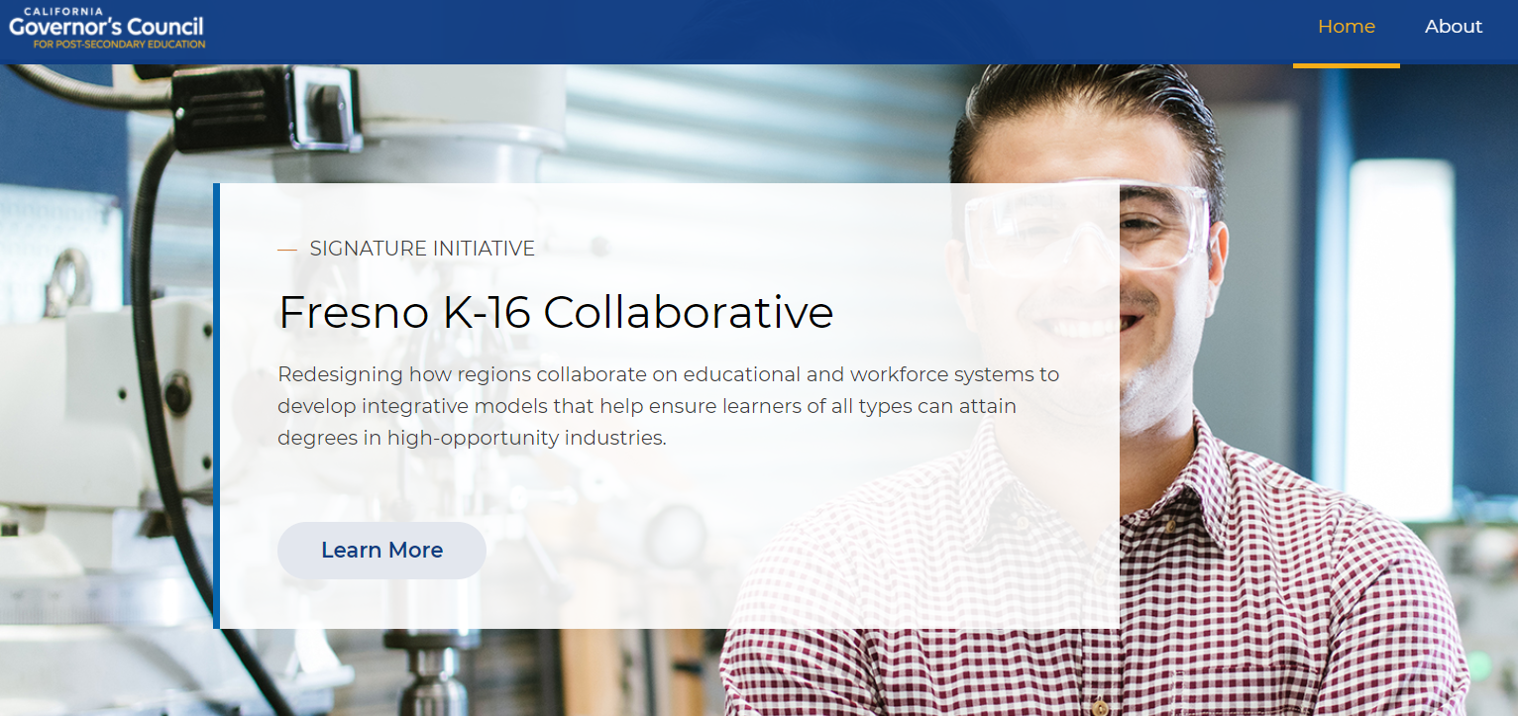
Governor’s Council for Postsecondary Education Website https://www.capostsecondaryforall.org
The Governor convened the Council for Post-Secondary Education as an advisory body and sounding board for policy changes considered at the state level and within educational segments.
The Council is exploring and recommending new approaches to accelerate equitable student success across the state.
CAPostSecondaryForAll.org was launched to share the Council’s work, including signature initiatives:
  The Recovery With Equity Taskforce
  The Fresno K-16 Collaborative

Slide 4


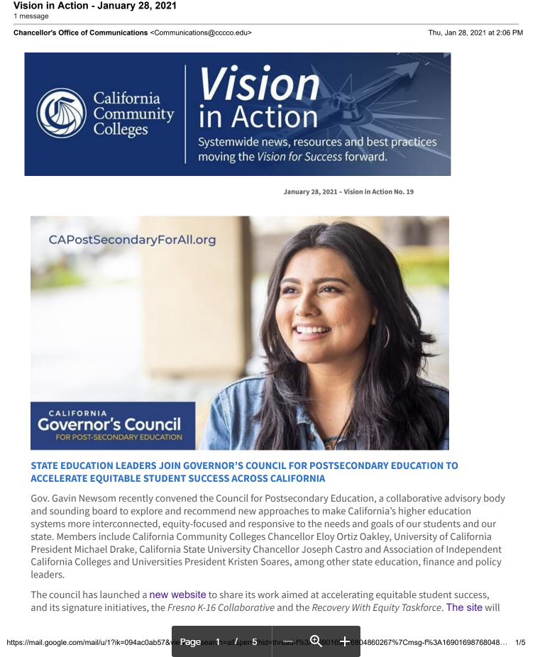



And…………
Notes:
109 former NCAA football players are on active rosters for Super Bowl LV between the Tampa Bay Buccaneers and Kansas City Chiefs in Tampa on Sunday, Feb. 7.
TB Buccaneer
Ronald Jones II #27 RB USC
Alex Capp Humboldt State
College that claims the most Superbowl athletes – LSU with 6
3 hail from the Mountain West conference that Fresno State is a part of (SEC has 24)
Tom Brady – Michigan
Patrick Mahomes – Texas Tech
6 TB and 1 KC born in CA
FL has 6 & 6

Slide 5

Collaborative Partner 2yr Pilot Pathway Projects
Accounting & Financial Mgt.
Engineering
Single Subject Teachers
Education – Dual Enrollment Teachers (Upskilling - Master’s degrees for high school teachers to teach dual enrollment)
115
Teachers
8.15%
Investment YTD | Students | Teachers
$ 7,532,313 | 1296 | 115
Total human touchpoints | 1411 | student/ teachers*
 | $ 5,338.28 | investment per student/ teachers
1106
Students- High School & Transfers
78.38%
*Not inclusive of the of teachers, faculty, staff participating in trainings/PD and REI PD to faculty, staff, teachers, admin, community - est. >1000; Round 2 proposals under development including the virtual DE Hub; and Bridge-Type Programs, collectively >1000
Notes:
Total 1411 8.15% teachers (#115)
91.85% student (#1296) (78.38% hs#1106; 13.47 a#190)
100% student investment
Investment Students-1411
HS & Transfer 1106
Masters' Candidates 115
Adult Learners 190
NOTE: Great news! These proposal commitments are not inclusive of teachers, faculty, staff participating in trainings/PD and REI PD to faculty, staff, teachers, admin, community - est. >1000; Round 2 proposals under development including the virtual DE Hub; and Bridge-Type Programs, collectively >1000

Slide 6
 | Collaborative Partner | Award | Students | Teachers | Pathways**
1 | Fresno Unified School District | $ 590,000 | 68 |  | Eng, Acctg, SS Teach
2 | Sanger Unified School District | $ 590,000 | 200 |  | Eng
3 | Central Unified School District | $ 590,000 | 60 |  | SS Teach, Acct, Eng.,MA
4 | Fresno City College | $ 351,658 | 160 |  | Acctg
5 | Reedley College | $ 590,000 | 158 |  | Eng
6 | Brandman University | $ 349,320 | 105 |  | Acct**
7a | Fresno State - Acctg | $ 590,000 | 60 |  | Acctg
7b | Fresno State - SS Teacher |  | 20 |  | SS Teach***
7c | Fresno State - Eng |  | 97 |  | Eng
8 | Clovis Community College | $ 590,000 | 60 |  | SS Teacher
9 | Fresno Pacific University | $ 590,000 |  | 70 | SS Teach, Acct, MA
 |  |  | 9
10 | Fresno County Superintendent of Schools | $ 585,696 |  |  | MA
11 | Central Valley Higher Education Consortium | $ 110,000
12 | National University | $ 480,000
13 | Clovis Unified School District (12/4) | $ 467,317 | 234 | 5 | SS Teacher, Acct, MA
14 | UC Merced, SCCCD, Collab partners,other |  | tbd | tbd
R2-1 | Adult Learners (SCCCD/SCAEC/FCC + FPU/NU/BU) | $ 57,823 | 65 |  | Acct ***
R2-2 | C2C Unique ID Creation & Data Sharing | $ 180,000 | na | na | Key element: IT/Data
R2-3 | Overarching Race Equity Inclusion (FCC+CVHEC) | $ 245,500 | na | na | Key element: Race Equity Inclusion & Outreach; Support Systems
R2-4 | MA Upskilling Regionally for Sustainability (CVHEC,NU,FPU) | $ 575,000 | na | 40 | MA
R2-5 | Virtual Dual Enrollment HUB (proposal inder development) | tbd | tbd | na | Key Elements: Equity, DE, Support Systems, Virtual Labs, Shared Assets; under development
 | Total ytd | $ 7,532,313 | 1296 | 115
Proposals by the Number
(2/2021)
Total Ask to Date:
$7,532,313
Remaining Availability:
$1,968,875
(proposals under development or anticipated are expected to utilize the remaining available funds)
TOTALS:
Investment YTD | Students | Teachers | * Does not include teachers, faculty, staff participating in trainings/PD. Not inclusive of proposals being edited (BU); and Round 2 proposals under devt for adult learners, regional upskilling, data, virtual DE Hub and REI PD to faculty, staff, teachers, admin, community est. >1000 or Bridge-Type Programs, collectively >1000
$ 7,532,313 | 1296 | 115
Total human touchpoints | 1411 | student/ teachers*
 | $5,338.28 | investment per student/ teachers | **Although a Collab Partner may have written proposals specific to one pathway, most partners are participating 2-3 pathways. ***targets adult learners
Notes:
Proposals addressing each of the pathways
AND
Additional proposals under development:
Race Equity & Inclusion for Collaborative Partner Professional Development/Training and Community
Adult Education Accounting Cohort and targeted outreach
Development of a Dual Enrollment Virtual HUB for High School & Adult Learners
Data Sharing, creation of Unique IDs, DE Dashboard
DE Upskilling Regionwide

Slide 7
Investment Breakdown by FY1 and FY2
 |  | FY 7/1/20 ‐ 6/30/21 | FY 7/1/21 ‐ 12/31/21 | SUBRECIPIENT TOTAL
TOTAL AMOUNT ALLOWED PER YEAR, PER PRIME AWARD |  | $ 5,650,000 | $ 3,851,188 | $ 9,501,188
TOTAL OF PROPOSAL BUDGETS |  | $ 3,672,049 | $ 3,860,266 | $ 7,532,315
AVAILABLE_ ALLOWED (‐ MINUS ‐) PROPOSAL BUDGETS |  | $ 1,977,951 | -$ 9,078 | $ 1,968,873
Notes:
19 total projects awarded to date
Proposals by the Number
Encumbered: Remaining Availability:
$7,532,315 $1,968, 873
FY 7/1/20 ‐ 6/30/21 FY 7/1/21 ‐ 12/31/21 SUBRECIPIENT TOTAL
TOTAL AMOUNT ALLOWED PER YEAR, PER PRIME AWARD $ 5,650,000 $ 3,851,188 $ 9,501,188
TOTAL OF PROPOSAL BUDGETS $ 3,672,049 $ 3,812,966 $ 7,532,315
AVAILABLE_ ALLOWED (‐ MINUS ‐) PROPOSAL BUDGETS $ 1,977,951 -$ 9,078 $ 1,968,873

Slide 8
Investment Breakdown by FY1 and FY2
 |  | FY 7/1/20 ‐ 6/30/21 | FY 7/1/21 ‐ 12/31/21 | SUBRECIPIENT TOTAL
TOTAL AMOUNT ALLOWED PER YEAR, PER PRIME AWARD |  | $ 5,650,000 | $ 3,851,188 | $ 9,501,188
TOTAL OF PROPOSAL BUDGETS |  | $ 3,672,049 | $ 3,860,266 | $ 7,532,315
AVAILABLE_ ALLOWED (‐ MINUS ‐) PROPOSAL BUDGETS |  | $ 1,977,951 | -$ 9,078 | $ 1,968,873
Notes:
19 total projects awarded to date
Proposals by the Number
Encumbered: Remaining Availability:
$7,532,315 $1,968, 873
FY 7/1/20 ‐ 6/30/21 FY 7/1/21 ‐ 12/31/21 SUBRECIPIENT TOTAL
TOTAL AMOUNT ALLOWED PER YEAR, PER PRIME AWARD $ 5,650,000 $ 3,851,188 $ 9,501,188
TOTAL OF PROPOSAL BUDGETS $ 3,672,049 $ 3,812,966 $ 7,532,315
AVAILABLE_ ALLOWED (‐ MINUS ‐) PROPOSAL BUDGETS $ 1,977,951 -$ 9,078 $ 1,968,873

Slide 9


Pilot Pathway: Education – Dual Enrollment Teachers
Upskilling Master’s
UPDATES
1.0 Central, Clovis, Fresno & Sanger USDs #75
2.0 Fowler, Madera, Washington, Yosemite USDs #40
Notes:
Upskilling of Teachers – math and English
Related Examples – such as Single Subject Teaching Pathways (not exhaustive):
Guided Pathway –Clovis USD to Clovis CC to Fresno Pacific
UPSKILLING PARAPROFESSIONAL OF COLOR TO BECOME AREA TEACHERS Fresno State targeting Fresno USD Paraprofessionals to complete their Single Subject Teaching Degree at Fresno State
National University MA, English cohort enrollments (1/12/20):
9 (10) Clovis USD
0 (1) FCSS
2 Central USD
4 Sanger USD
3 Fresno USD
18 (20)
Fresno Pacific University MA, Math January Cohort, start 1/12/2021
1.0 2.0
2 Clovis USD 1 Washington USD
0 FCSS 1 Fowler USD
0 Central USD 1 Yosemite USD
5 Sanger USD 1 Madera USD
12 Fresno USD 4
19

Slide 10


UPDATES
  Adult Learner Accounting and Finance Management DE Pathway and Direct Outreach Project to increase employability, educational attainment and socioeconomic mobility; as well as promote prior learning assessment/credit for prior learning (PLA/CPL) to recognize previously acquired education or vocational experiences.
  24 Enrolled, Jan 2021 @ FCC.
Accounting Bootcamp for
HS Students
20 target
70 registered – 46 attended day 1; 29 day 2
Collaborative effort of FCC and FPU

Slide 11
Key Deadlines
  March 19, 2021: Progress Report 1 (deadline extended from Feb 5th) summarizing plan implementation to date, activities and student cohort data to date.
  September 3, 2021: Progress Report 2 summarizing student outcomes to date (Spring 2021, Summer 2021, Fall 2021 cohort enrollments).
  December 31, 2021: Period of performance for each grant award concludes.
  January 28, 2022: Final invoicing for expenditure through December 31, 2021 due.
  January 28, 2022: Final Report summarizing student outcomes through the end of the performance period and projected to the end of the Academic Year 2021-22

Slide 12

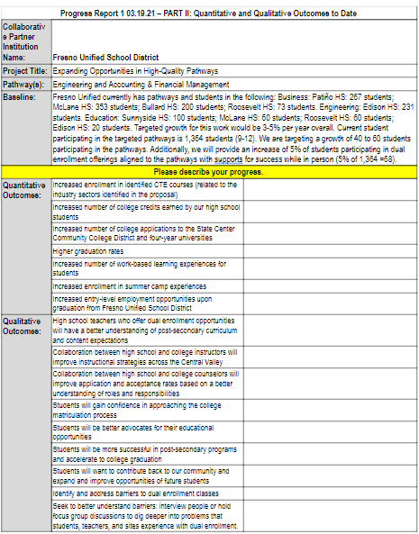
Progress Report 1 –
Due March 19, 2021
Part I:Narrative
Part II: Quantitative & Qualitative Outcomes to Date
Progress Report 1 03.19.21 - PART I: Narrative
Collaborative Partner Institution Name: | CVHEC
Project Title: | Dual Enrollment Teach Upskilling Pathway – MA degrees for English High School Teachers
Pathway(s): | Teacher’s Masters to enable Dual Enrollment
Please provide a narrative describing efforts and milestones reached to date.

Slide 13
Roundtable - Pilot Pathway Working Groups/Communities of Practice Updates
Accounting and Fiscal Management/Dual Enrollment Pathway Fresno Unified School District Central Unified School District Clovis Unified School District Fresno City College Reedley College* Clovis Community College* Fresno State Fresno Pacific University Brandman University*** SCCCD*** UC Merced* Student Impact: __522____ | Engineering/ Dual Enrollment Pathway Sanger Unified School District Fresno Unified School District Central Unified School District Reedley College Clovis Community College* Fresno City College* Fresno State Engineering UC Merced* Student Impact: __498____
Single-Subject Teaching/Dual Enrollment Pathway Clovis Unified School District Central Unified School District Fresno Unified School District Clovis Community College Fresno City College* Reedley College* Fresno Pacific University Fresno State Brandman University* Student Impact: __276____ | Upskilling Masters for Dual Enrollment Pathway Central Valley Higher Education Consortium National University Fresno Pacific University Fresno County Superintendent of Schools Clovis Unified School District Sanger Unified School District Fresno Unified School District* Central Unified School District* Student Impact: __115__
*Proposal not submitted; included in the Community of Practice; **Although a Collab Partner may have written proposals specific to one pathway, most partners are participating 2-3 pathways; ***targets adult learners
Pathway
Spring 2021 Objectives & Outcomes
Notes:
CREATION OF
an integrated, replicable, regional K-16 educational system foundation to address race equity and inclusion of our most vulnerable student populations systemically and sustainably by:
improving socioeconomic mobility with increased educational attainment levels
increasing employability in high demand, living wage jobs
lowering the poverty rate
Curriculum alignment agreements with recognized co-curricular, course mapping sequences from high school dual enrollment to community college to four-year institutions for the DE pilot pathways.
Snapshots of Success Deliverables include:
Equitable access to dual enrollment/college credit with intentional student success support.
Foundational implementation of dual enrollment in labor market supported pathways leading to living-wage job opportunities.
Curriculum alignment agreements with recognized co-curricular, course mapping sequences from high school dual enrollment to community college to four-year institutions for the DE pilot pathways.
Upskilled teachers eligible to teach DE and increase capacity of DE offerings.

Slide 14
Roundtable - Pilot Pathway Working Groups/Communities of Practice Updates
o Accounting and Fiscal Management/ Dual Enrollment (Goldsmith/Jimenez-Sandoval)
o Engineering/ Dual Enrollment (Buckley/Jimenez-Sandoval)
o Education – Single Subject Teachers/ Dual Enrollment (Bennett/Hoff) (4/9/21)
o Education – Upskilling Masters for Dual Enrollment (Duran/Hoff) (4/9/21)
o Race, Equity, Inclusion (Goldsmith)
o C2C Data Collaboration
o Adult Learners (Hammerstrom/Watkins)
o Other
Notes:
Bootcamp Details
Overall Program/Format
Intro to accounting, financial statement activity, Kahoot!, 2 dynamic guest speakers
FPU students to assist
Dates
Jan. 5-6, 2021 10:30 a.m. - 12:00 p.m.
Participation Limit
No limit at this time

Slide 15



Next Fresno K-16 Collaborative
Executive Steering Committee Meetings:
Friday, April 9, 2021, 3:00-4:30pm
Friday, June 4, 2021, 3:00-4:30

